Slide 1
3D Compton Imaging: A new modality for Nuclear Medecine at 511 KeV and above
Authors A. Iltis¹, G. Zeufack¹, M. Lopez¹, H. Snoussi², L. Zimmer^{3,4}, N. Costes³, C. Bouillot³, Z. Hmissi¹, F. Lavenne³, J. Redoute³
¹Damavan Imaging, Rosieres pres Troyes, FRANCE,
²Université de Technologie de Troyes (UTT), Troyes, FRANCE,
³CERMEP-Imagerie du vivant, Bron, FRANCE,
⁴INSERM, CNRS, Université de Lyon, Lyon, FRANCE
Damavan Imaging
10/2020

Slide 2
Temporal δ Compton camera: How does it work?
Image from time
10/2020

Slide 3
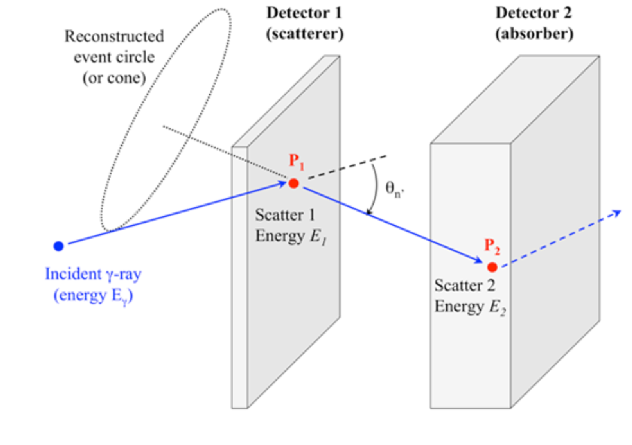
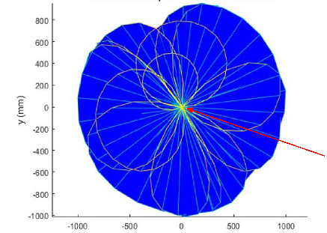
How does it work?
The principle of Compton Camera:
A Probabilistic map of cone intersections
3
Compton events detected on 2 successive plates
A cone which includes the incident photon direction is calculated
The source is found by intersecting many cones
Retro- projection image is then done
Notes:
One cone per photon => many cones needed => a number of events (statistics) necessary

Slide 4
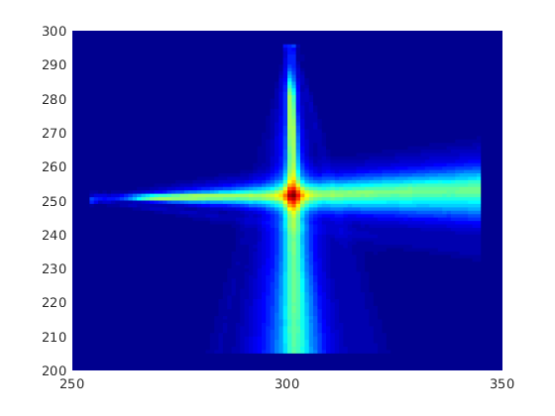
How does it work?
2D Vs 3D Compton imaging
4
Single view = 2D All the cones share the same origin
Ambiguity of reconstruction on the axis of view
3 Views (X,Y,Z) = 3DSampling of all space direction
No Ambiguity of reconstruction
More precise position
Notes:
One cone per photon => many cones needed => a number of events (statistics) necessary

Slide 5
How does it work?
Compton 2D and 3D imaging tools
5

Slide 6
What does Compton imaging bring to medical imaging?
Image from time
10/2020

Slide 7
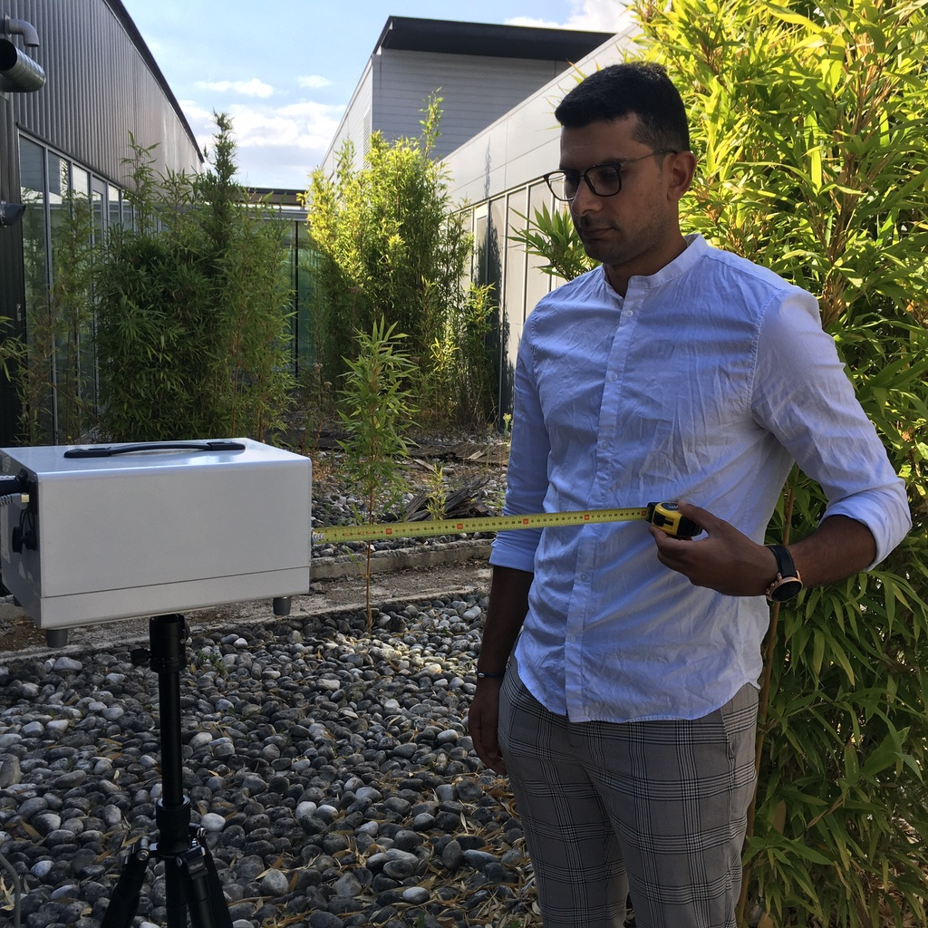
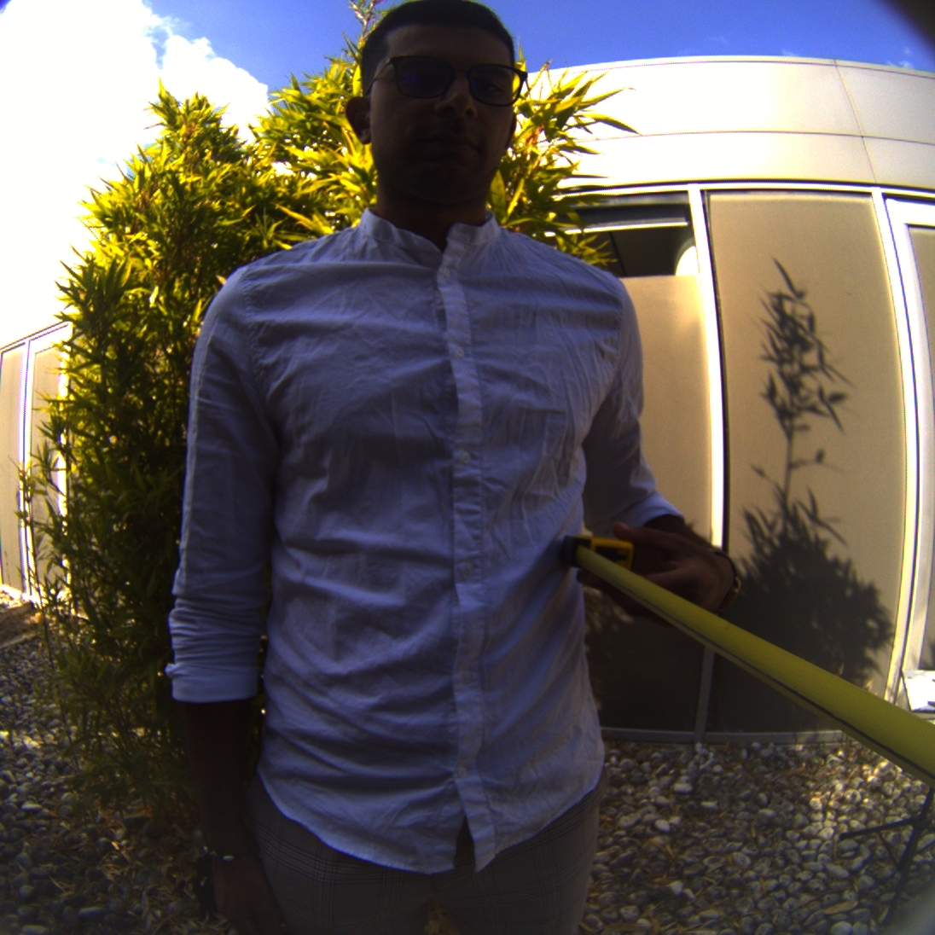
What does Compton imaging bring to medical imaging?
Ease of use and Wide Field of View:
90°x90° in one image
7
The set-up
FOV of our camera 50cm
Visible and Gamma

Slide 8
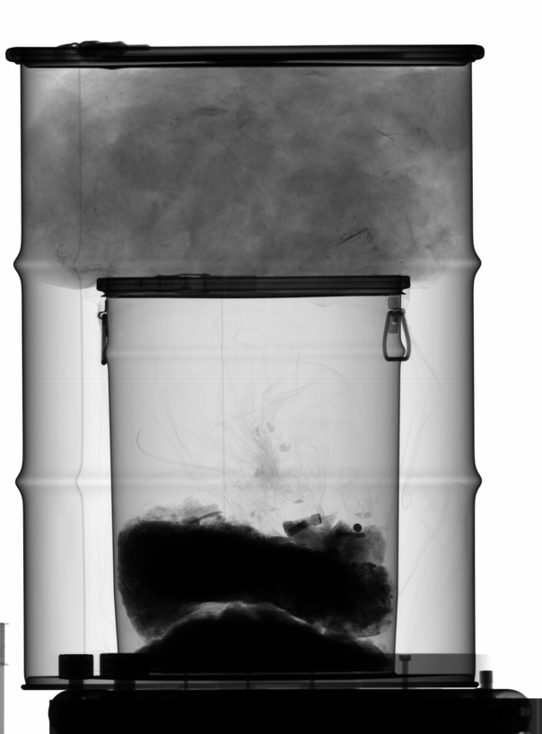
What does Compton imaging bring to medical imaging?
Capacity to make good images at high energy (1,3 MeV) with low dose (Radiotherapy)
8
X-Ray
Imaging ⁶⁰Co
1.3 MeV at 1.3 m
4.5 MBq / 20 min
Notes:
A gamma-mage gated on the energy 1332 KeV (here we see only the activity of ⁶⁰Co) shows that the main source in the bottom right corner corresponds to ⁶⁰Co. The image is much clearer, because most diffused photons are excluded.
One can also see the contour of the small barrel, likely scattered photons on the solid body of the small barrel or Co powder accumulation on it.
No ⁶⁰Co on the upper third of the drum is visible => different source (RONA: what is it in this case = glass wool).

Slide 9
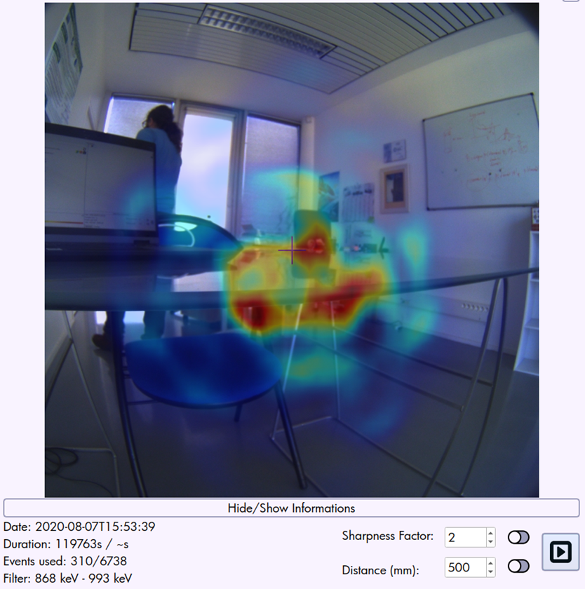
What does Compton imaging bring to medical imaging?
Images of weak sources till natural background
glass plate from its natural ²²⁸Ac contamination
9

Slide 10
What does Compton imaging bring to medical imaging?
Comparison of 3D Compton with existing nuclear medicine modalities
10
 | SPECT | PET | Compton 3D
Energy range | 50-250 KeV | 511 KeV | 400-2000 KeV
Detector acceptance angle | 5° x 5° | 0,2° x 0,2° | 90° x 90°
Spatial resolution | +/- 0,2 cm³ | 0,03 cm³ | <0,3 cm³ TBD
Reconstruction method | 2D retroprojection | sinogram | 3D Cone intersection
Notes:
A gamma-mage gated on the energy 1332 KeV (here we see only the activity of ⁶⁰Co) shows that the main source in the bottom right corner corresponds to ⁶⁰Co. The image is much clearer, because most diffused photons are excluded.
One can also see the contour of the small barrel, likely scattered photons on the solid body of the small barrel or Co powder accumulation on it.
No ⁶⁰Co on the upper third of the drum is visible => different source (RONA: what is it in this case = glass wool).

Slide 11
Temporal δ Compton camera 3D imaging
Image from time
10/2020
Notes:
CeBr3 = Cerium Bromide
Z effective: between 1 atom of Ce and 3 atoms of Brome
Spatial resolution in the crystal: 1.5 mm
Extremely short time vetoes => Invalid events can be discarded in our temporal system if:
The relationship θ_{n} = f (E_{1/} E_{g} ) is incorrect (partial energy deposition)
The events P1 and P2 are not within tight time limits (<300 ps).
very effective photons detection: + 50% more photons captured for the same time
faster acquisition: 30-50%
Depth Of Interaction (DOI)

Slide 12
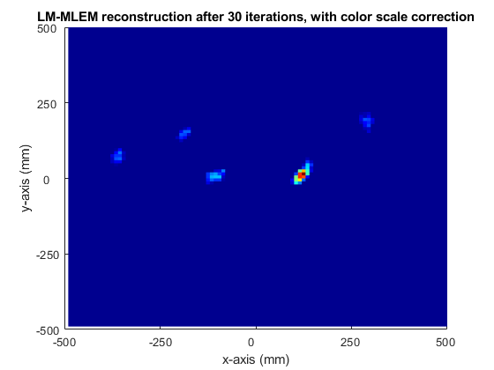
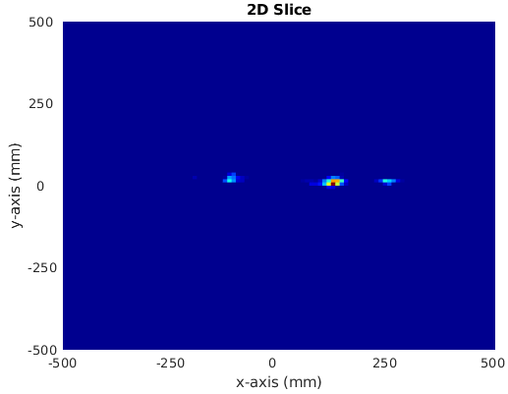
Temporal δ Compton camera 3D imaging
Images 2D vs 3D: ²²Na sources (15 KBq)
12
2D reconstruction
Source apparent size 3cm
3D reconstruction : 2D slice
No artefacts
Source size = 2 cm = actual size

Slide 13
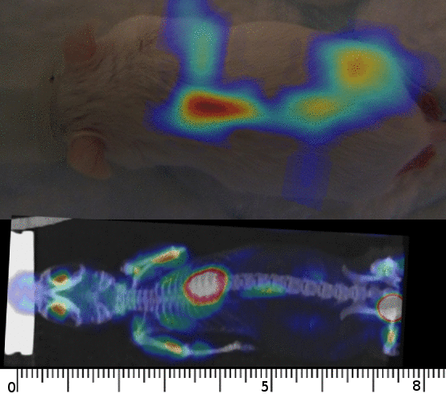
Temporal δ Compton camera 3D imaging
3D slices of a 80mm mouse (5000 photons)
Glucose¹⁸F / 0.51 MBq /3 x 10mn Views
13
²²Na vs ¹³⁷Cs : 20 cm seen from 50 cm
²²Na vs ¹³⁷Cs : 20cm seen from 50cm

Slide 14
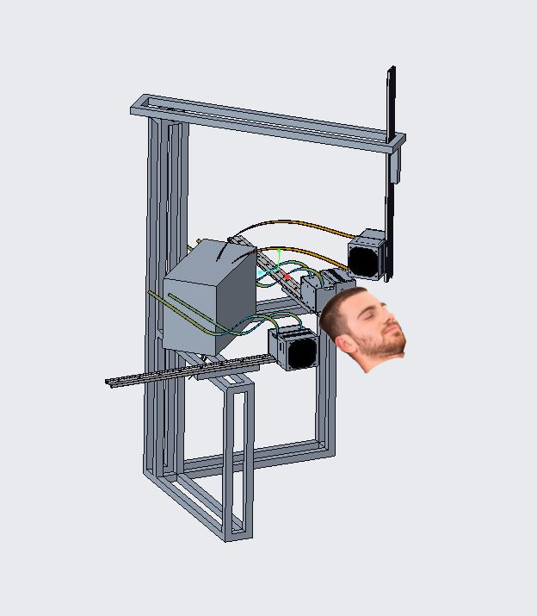
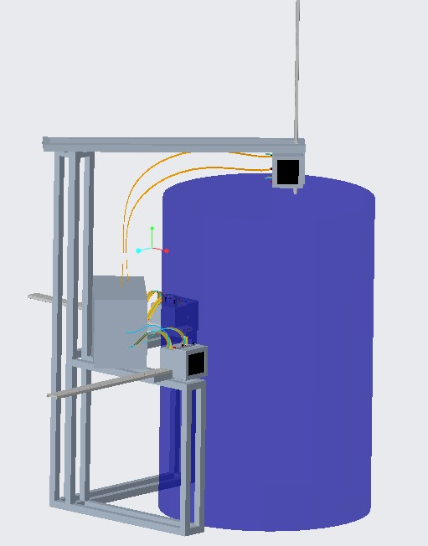
Temporal δ Compton camera 3D imaging
Future steps: dedicated 3D scanner
14

Slide 15
3D Compton Imaging: A new modality for Nuclear Medecine at 511 keV and above
Alain.iltis@damavan-imaging.com
www.damavan-imaging.com
Damavan Imaging
10/2020

